Slide 1
PSG HACKATHON SOCIETE GENERALE 2024
SOLUTION BY :
SANJAY S (21PW29)
VAMSI KRISHNA U (21PD38)

Slide 2
TOPIC
AUTOMATION OF VBA MACROS DOCUMENTATION
Theme: The goal is to develop a solution that automates the documentation and understanding of legacy VBA macros used in critical processes across DFIN, facilitating their transformation into modern technologies and IT platforms.

Slide 3





TOOLS/LANGUAGES USED
Python (with FLASK as framework)
HTML/CSS
Javascript
VS CODE AND GITHUB

Slide 4
Process:
Creating automatic documentation for VBA macros involves several steps to ensure a streamlined and efficient process.
Upload the Excel File: We began by uploading an Excel file (.xlsm) containing the VBA macros we needed to document.
Extract VBA Code: Using specialized parsers, we were able tp extract the VBA code from the uploaded file
Analyze the Code: We analyzed the extracted code to identify functions, variables, comments, and logical structures.
Generate the PDF Document: Using the analyzed data, we generated a detailed PDF document. This document will include clear formatting and organized sections for each part of the code.
The macro we used here, generally cleans the numeric data which doesn’t allow duplicated rows, empty rows and non integer rows (which is essential for data cleaning)

Slide 5
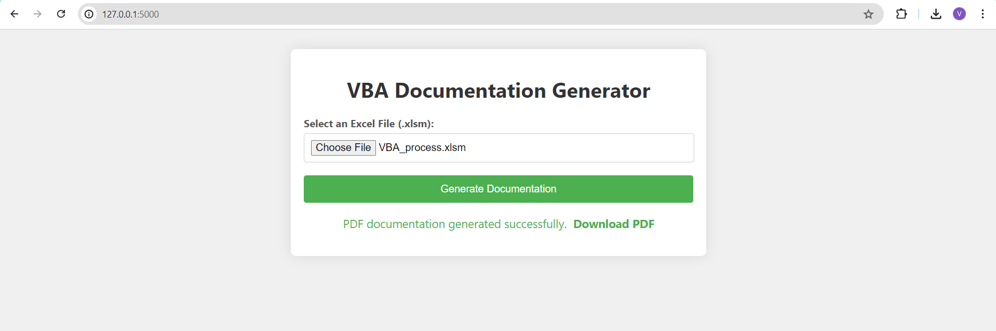
FRONT - END

Slide 6
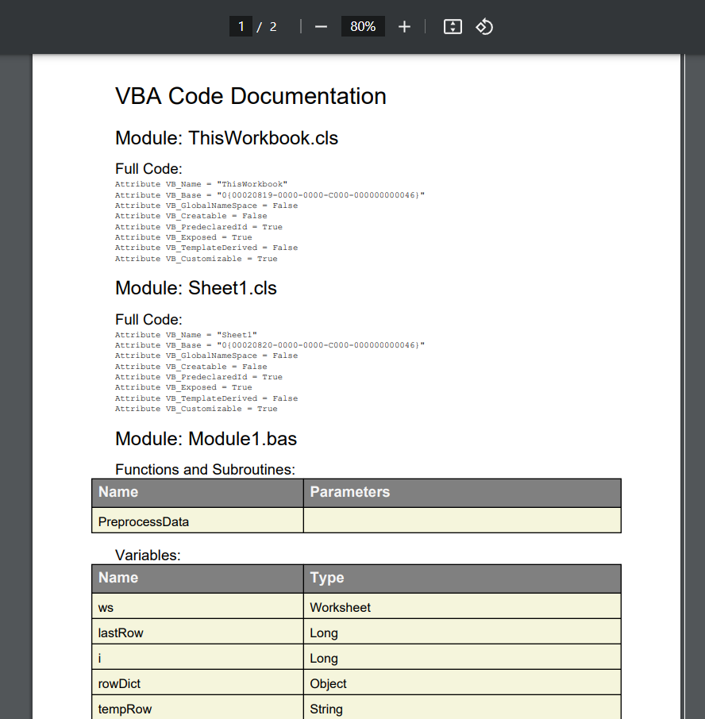

Slide 7
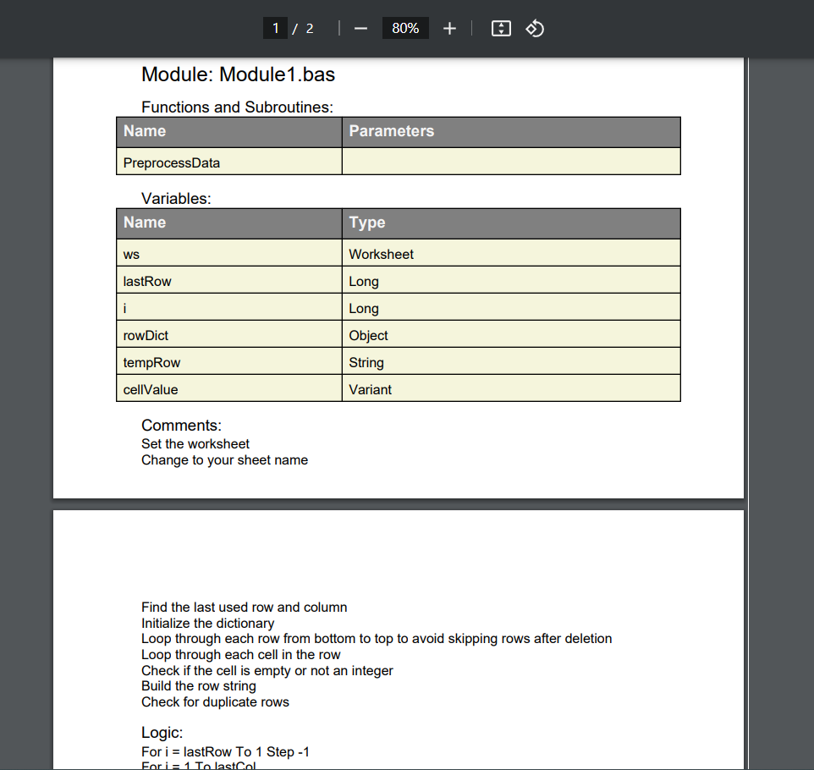

Slide 8
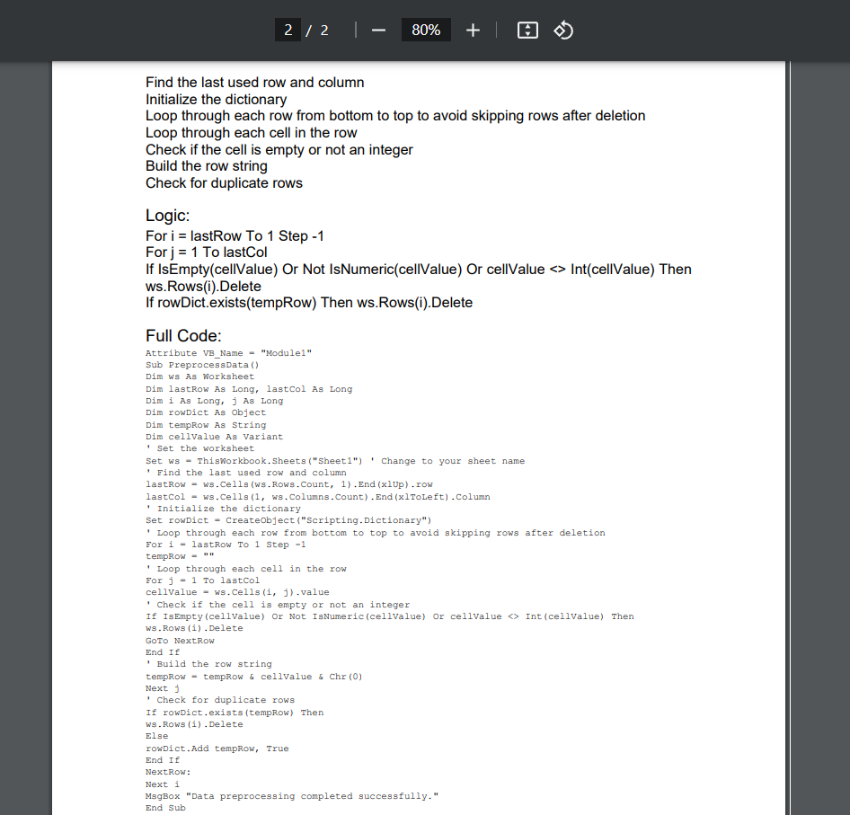

Slide 9
THANK YOU !

